Slide 1

Cryptanalysis
Prepared by:
Dr. Muhammad Iqbal Hossain
Associate Professor
Department of CSE, BRAC University

Slide 2
Cryptanalysis
Cryptography - study of encryption principles/methods.
Cryptanalysis (code breaking) - study of principles/methods of deciphering ciphertext without knowing key.
Cryptographic systems are generically classified along three independent dimensions.

Slide 3
How to attack
Brute force attack
Cryptanalysis
Side channel analysis

Slide 4
Cryptanalysis
The type of operations used for transforming plaintext to ciphertext.
1.1 Substitution:
  Each element (bit, letter, group of bits or letters) in the plaintext is mapped into another element.
  1.2 Transposition:
  Elements in the plaintext are rearranged.
  Fundamental requirement is that no information be lost.
  Product systems involve multiple stages of substitutions and transpositions.

Slide 5
Cryptanalysis
2. The number of keys used.
Referred to as symmetric, single-key, secret-key, or conventional encryption if both sender and receiver use the same key.
Referred to as asymmetric, two-key, or public-key encryption if the sender and receiver each use a different key.

Slide 6
Cryptanalysis
3. The way in which the plaintext is processed.
A block cipher processes the input one block of elements at a time, producing an output block for each input block.
A stream cipher processes the input elements continuously, producing output one element at a time, as it goes along.

Slide 7
Cryptanalysis
The strategy used by the cryptanalyst depends on the nature of the encryption scheme and the information available to the cryptanalyst.
  Cipher text Only
  Known Plaintext
  Chosen-plaintext
  Chosen-Cipher text

Slide 8
Cryptanalysis
1. Ciphertext Only:
  The cryptanalyst knows ciphertext only.
  Uses brute-force approach - try all possible keys.
  Make the key space very large so it becomes impractical.
  Easiest to defend
Encryption
Decryption
Plaintext
Ciphertext
key
key
Notes:
During ciphertext-only attacks, the attacker has access only to a number of encrypted messages. He has no idea what the plaintext data or the secret key may be. The goal is to recover as much plaintext messages as possible or (preferably) to guess the secret key. After discovering the encryption key, it will be possible to break all the other messages which have been encrypted by this key.
While designing encryption algorithms, it is particularly important to secure them against ciphertext-only attacks, as they are the most obvious starting point for every cryptanalysis. That is why well prepared and reviewed ciphers are usually not very vulnerable to these kinds of attacks. However, one may still find examples of protocols that have been broken by various attacks based on ciphertext-only approach.
There are a few techniques which proved to be very effective even when targeting modern ciphers and which are based only on the knowledge of the ciphertext messages. The most important methods are:
Attack on Two-Time Pad
Frequency Analysis

Slide 9
Cryptanalysis
2. Known plaintext:
  The analyst may be able to capture one or more plaintext messages as well as their encryptions.
  Or he may know that certain plaintext patterns will appear in a message.
  May deduce the key.
Encryption
Decryption
Plaintext
Ciphertext
key
key
Notes:
Knows some plaintext and corresponding cipher text.
Old communication
Goal is to find the key
During known-plaintext attacks, the attacker has an access to the ciphertext and its corresponding plaintext. His goal is to guess the secret key (or a number of secret keys) or to develop an algorithm which would allow him to decrypt any further messages.

Slide 10
Cryptanalysis
3. Chosen-plaintext:
  A cryptanalyst can choose arbitrary plaintext data to be encrypted and then he receives the corresponding ciphertext.
  If the analyst is able to choose the messages to encrypt, the analyst may deliberately pick patterns that can be expected to reveal the structure of the key.
Generator
Encryption
Decryption
Plaintext
Ciphertext
key
key
Notes:
Oscar can choose plaintext and get ciphertext
Key builtin
During the chosen-plaintext attack, a cryptanalyst can choose arbitrary plaintext data to be encrypted and then he receives the corresponding ciphertext. He tries to acquire the secret encryption key or alternatively to create an algorithm which would allow him to decrypt any ciphertext messages encrypted using this key (but without actually knowing the secret key).
This is a rather comfortable situation for the attacker. He can obtain more information about the secret key and about the whole attacked system, because he is able to choose any text to be processed by the cipher. He can analyse the system behaviour and output ciphertext, based on any kind of input data. During breaking deterministic ciphers with the public key, the intruder can easily create a database with popular ciphertexts, for example with popular queries to the server. After that he will be able to find the meaning of many intercepted encrypted messages, by simply comparing them with his own database entries. The most known chosen-plaintext attacks were performed by the Allied cryptanalysts during World War II against the German Enigma ciphers.

Slide 11
Cryptanalysis
4. Chosen-Ciphertext:
  a cryptanalyst can analyse any chosen ciphertexts together with their corresponding plaintexts
  If the analyst is able to choose the messages to decrypt, the analyst may deliberately pick patterns that can be expected to reveal the structure of the key.
  used for breaking systems with public key encryption
Generator
Encryption
Decryption
Plaintext
Ciphertext
key
key
Notes:
Oscar can choose ciphertext and get plaintext.
Key inbuilt
During the chosen-ciphertext attack, a cryptanalyst can analyse any chosen ciphertexts together with their corresponding plaintexts. His goal is to acquire a secret key or to get as many information about the attacked system as possible.
The attacker has capability to make the victim (who obviously knows the secret key) decrypt any ciphertext and send him back the result. By analysing the chosen ciphertext and the corresponding received plaintext, the intruder tries to guess the secret key which has been used by the victim.
Chosen-ciphertext attacks are usually used for breaking systems with public key encryption. For example, early versions of the RSA cipher were vulnerable to such attacks. They are used less often for attacking systems protected by symmetric ciphers. Some self-synchronizing stream ciphers have been also attacked successfully in that way.

Slide 12
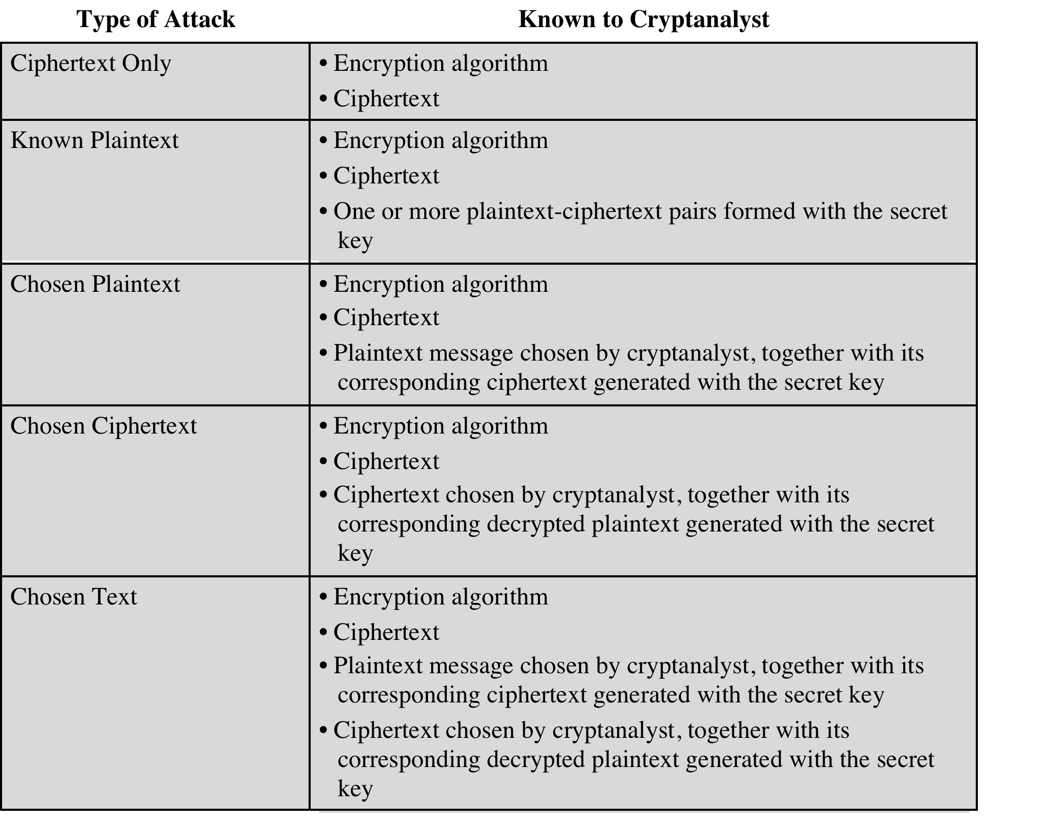
Cryptanalysis

Slide 13
Cryptanalysis
Chosen ciphertext and chosen text are less commonly employed as cryptanalytic techniques but are nevertheless possible avenues of attack.
Only a relatively weak algorithm will fail to withstand a ciphertext-only attack.
Generally, an encryption algorithm is designed to withstand a known-plaintext attack.
An encryption scheme is computationally secure if ciphertext generated by the scheme meets one or both of the criteria:
The cost of breaking the cipher exceeds the value of the encrypted information.
The time required to break the cipher exceeds the useful lifetime of the information.

Slide 14
Cryptanalysis
Brute Force attack:
Involves trying every possible key until an intelligible translation of the ciphertext into plaintext is obtained
On average, half of all possible keys must be tried to achieve success.
Suppose that a cipher has a 100 bit key
  Then keyspace is of size 2¹⁰⁰
On average, for exhaustive search Trudy tests 2¹⁰⁰/2 = 2⁹⁹ keys
Suppose Trudy can test 2³⁰ keys/second
  Then she can find the key in about 37.4 trillion years

Slide 15
Why Study Cryptanalysis?
Study of cryptanalysis gives insight into all aspects of crypto
Also gain insight into attacker’s mindset
  “black hat” vs “white hat” mentality
Cryptanalysis is more fun than cryptography
  Cryptographers are boring
  Cryptanalysts are cool
But cryptanalysis is hard

